Slide 1
Chapter 11: Build a Small Network
Introduction to Networks v5.1

Slide 2
Chapter Outline
11.0 Introduction
11.1 Network Design
11.2 Network Security
11.3 Basic Network Performance
11.4 Summary

Slide 3
Section 11.1: Network Design
Upon completion of this section, you should be able to:
Identify the devices used in a small network.
Identify the protocols used in a small network.
Explain how a small network serves as the basis of larger networks.

Slide 4
Topic 11.1.1: Devices in a Small Network

Slide 5
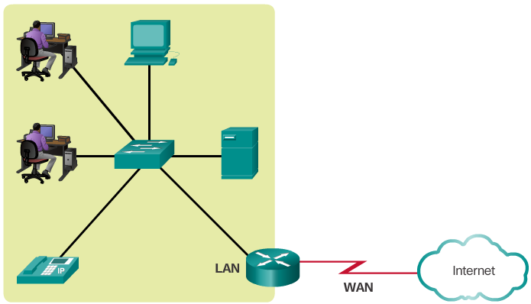
Small Network Topologies
Typical Small Business Network
Small networks have simple designs.
Only a small number of network devices are needed.
A small network usually comprises one router, a couple of switches, and the user PCs.
A connection to the Internet is achieved through a single WAN link (commonly either cable or DSL).
Most of the managing task is related to maintaining and troubleshooting existing equipment.
The management of a small network is usually done by an employee of a third party company.
Notes:
11.1.1.1 Small Network Topologies

Slide 6
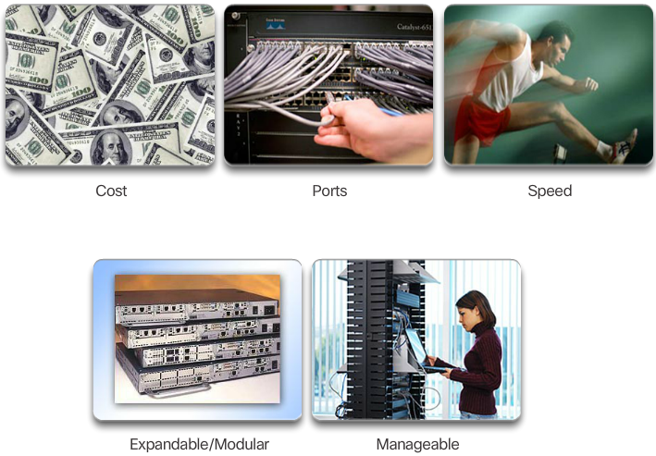
Device Selection for a Small Network
Factors to consider when choosing a device in addition to those listed in the graphic include OS features:
Security
QoS
VoIP
L3 switching
NAT
DHCP
Notes:
11.1.1.2 Device Selection for a Small Network

Slide 7
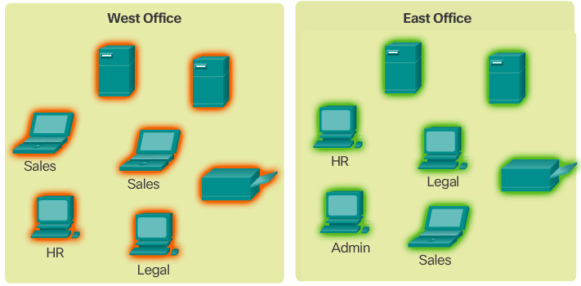
IP Addressing for a Small Network
Address space is a crucial component of a network design.
All devices connected to the network require an address.
The address scheme must be planned, documented, and maintained.
Address space documentation can be very useful for troubleshooting.
Address documentation is also very important when controlling resource access.
Notes:
11.1.1.3 IP Addressing for a Small Network

Slide 8
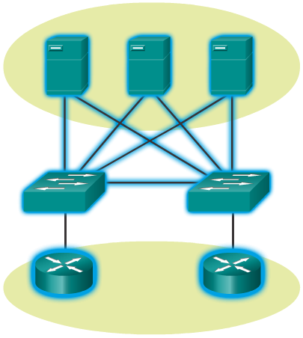
Redundancy in a Small Network
Redundancy to a Server Farm
A network should reliable by design.
Network failures are usually very costly.
Redundancy increases reliability by eliminating single points of failure.
Network redundancy can be achieved by duplicating network equipment and links.
A good example is a network’s link to the Internet or to a server farm.
Notes:
11.1.1.4 Redundancy in a Small Network

Slide 9
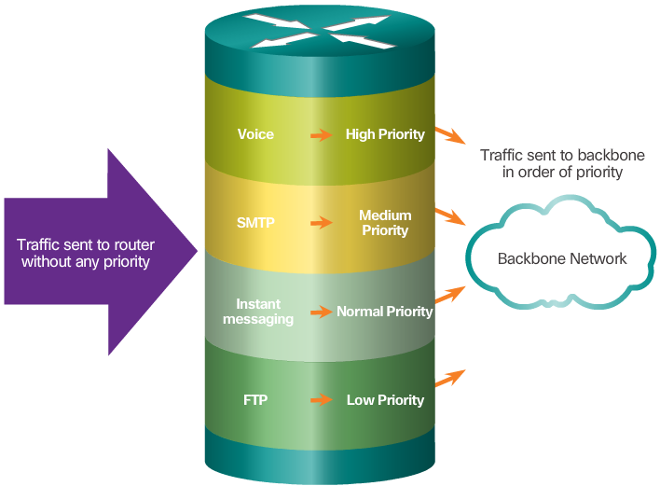
Traffic Management
Traffic type and patterns are should also be considered when designing a network.
A good network design categorizes traffic according to priority.
Notes:
11.1.1.5 Traffic Management

Slide 10
Topic 11.1.2: Small Network Applications and Protocols

Slide 11
Common Applications
Network Applications
Used to communicate over the network.
Email clients and web browsers are examples of this type of application.
Application Layer Services
Programs that interface with the network and prepare the data for transfer.
Each service uses protocols, which define the standards and data formats to be used.
Notes:
11.1.2.1 Common Applications

Slide 12
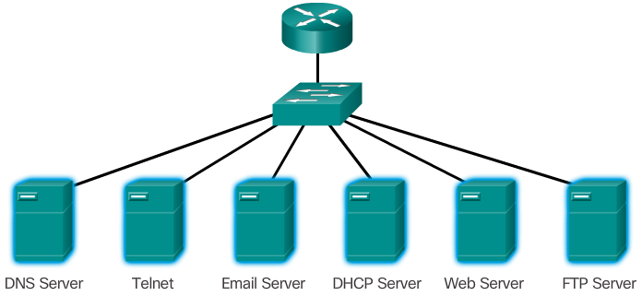
Common Protocols
Each of these network protocols define:
Processes on either end of a communication session
How messages are sent and the expected response
Types of messages
Syntax of the messages
Meaning of informational fields
Interaction with the next lower layer
Notes:
11.1.2.2 Common Protocols

Slide 13

Real-Time Applications
Basic components:
Infrastructure
VoIP
IP Telephony
Real-time Applications
Notes:
11.1.2.3 Real-Time Applications

Slide 14
Topic 11.1.3: Scale to Larger Networks

Slide 15

Small Network Growth
To scale a network, several elements are required:
Network documentation
Device inventory
Budget
Traffic analysis
Notes:
11.1.3.1 Small Network Growth

Slide 16
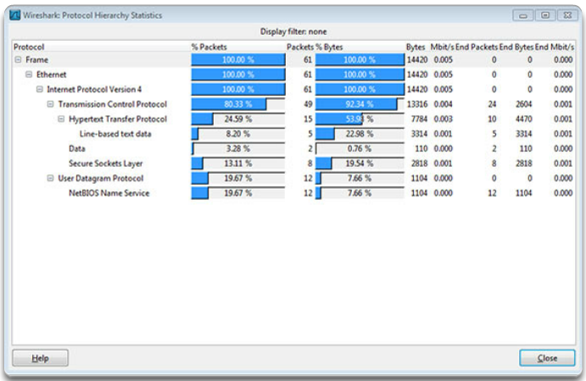
Protocol Analysis
A network administrator must understand the protocols in use in the network. Protocol analyzers are tools designed to help in that task.
For a more accurate protocol analysis, it is important to capture traffic in high-utilization times and in different locations of the network.
The result of the analysis allows for a more efficient way to manage traffic.
Notes:
11.1.3.2 Protocol Analysis

Slide 17
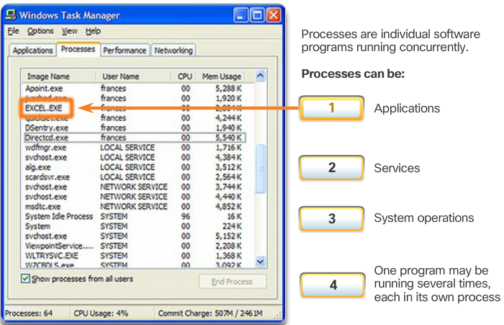
Employee Network Utilization
It is also important to be aware of how network use is changing.
A network administrator can create in-person IT “snapshots” of employee application utilization.
Notes:
11.1.3.3 Employee Network Utilization

Slide 18
Employee Network Utilization (cont.)
These snapshots typically include information such as:
OS and OS version
Non-network applications
Network applications
CPU utilization
Drive utilization
RAM utilization
Documented employee IT snapshots will go a long way toward informing of evolving protocol requirements.
A shift in resource utilization may require an adjustment of network resource allocations.
Notes:
11.1.3.3 Employee Network Utilization (Cont.)

Slide 19
Section 11.2: Network Security
Upon completion of this section, you should be able to:
Explain why security measures are necessary on network devices.
Identify security vulnerabilities.
Identify general mitigation techniques.
Configure network devices with device hardening features to mitigate security threats.
Apply the commands to back up and restore an IOS configuration file.

Slide 20
Topic 11.2.1: Security Threats and Vulnerabilities

Slide 21
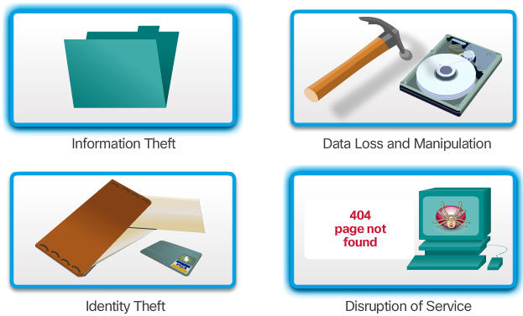
Types of Threats
Digital intrusion can be costly.
Intruders can gain access through software vulnerabilities, hardware attacks, or stolen credentials.
Common types of digital threats include those listed in this graphic.
Notes:
11.2.1.1 Types of Threats
Information Theft:
Breaking into a computer to obtain confidential information. Information can be used or sold for various purposes. Example: stealing an organization's proprietary information, such as research and development information.
Data Loss and Manipulation:
Breaking into a computer to destroy or alter data records. Examples of data loss: sending a virus that reformats a computer's hard drive. Examples of data manipulation: breaking into a records system to change information, such as the price of an item.
Identity Theft:
A form of information theft where personal information is stolen for the purpose of taking over someone's identity. Using this information, an individual can obtain legal documents, apply for credit, and make unauthorized online purchases. Identity theft is a growing problem costing billions of dollars per year.
Disruption of Service:
Preventing legitimate users from accessing services to which they should be entitled.Examples: Denial of Service (DoS) attacks on servers, network devices, or network communications links.

Slide 22
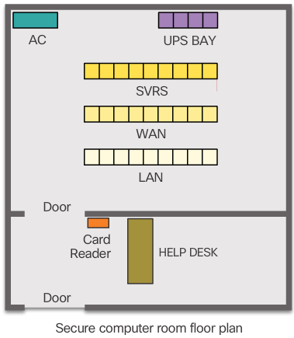
Physical Security
Classes of physical threats:
Hardware
Environmental
Electrical
Maintenance
Notes:
11.2.1.2 Physical Security
Lock up equipment and prevent unauthorized access from the doors, ceiling, raised floor, windows, ducts, and vents.
Monitor and control closet entry with electronic logs.
Use security cameras.

Slide 23
Types of Vulnerabilities
There are three primary vulnerabilities:
Technological - Vulnerabilities in protocols, operating systems, and network equipment
Configuration - Vulnerabilities created by misconfigured devices, default configuration values, and easily guessed passwords
Security policy - Lack of security policy, software and hardware installation is not consistent with security policy, and no disaster or recovery plan
Typically, the devices under attack are the endpoints, such as servers and desktop computers.
Any of these three vulnerabilities can be exploited and used in attacks.
Notes:
11.2.1.3 Types of Vulnerabilities
Technological: Vulnerabilities in Protocols, Operating Systems, Network Equipment
Configuration: Vulnerabilities created by misconfigured devices, default configuration values, easily guessed passwords, etc
Security policy: lack of security policy, software and hardware installation not consistent with security policy, no disaster or recovery plan.
11.2.1.4 Activity – Security Threats and Vulnerabilities

Slide 24
Topic 11.2.2: Network Attacks

Slide 25
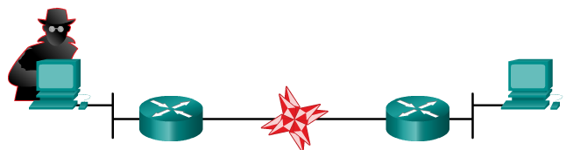
Types of Malware
Viruses
Worms
Trojan Horses
Notes:
11.2.2.1 Types of Malware

Slide 26
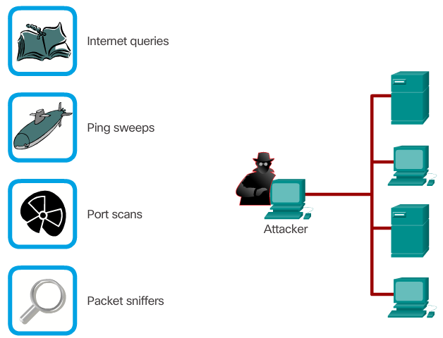
Reconnaissance Attacks
The discovery and mapping of systems and services
Often not considered an attack on its own
Goal is to acquire enough information on the target system or network to facilitate the search for vulnerabilities.
Common tools rely mostly on free and public Internet services, such as DNS and Whois.
Port-scanners and packet sniffers are also commonly used in reconnaissance.
Notes:
11.2.2.2 Reconnaissance Attacks

Slide 27
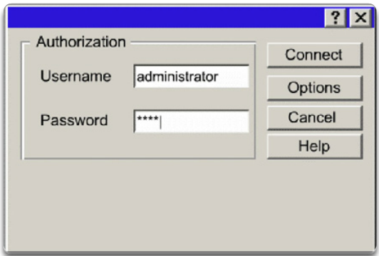
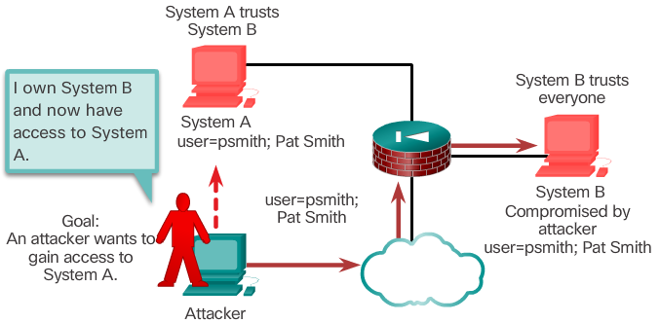
Access Attacks
Password Attack
Attacks against known vulnerabilities and services.
The goal is to gain access to information that they have no right to view.
Access attacks can be classified into four types:
Password Attacks
Trust Exploitation
Port Redirection
Man-in-the-Middle
Trust Exploitation
Notes:
11.2.2.3 Access Attacks

Slide 28
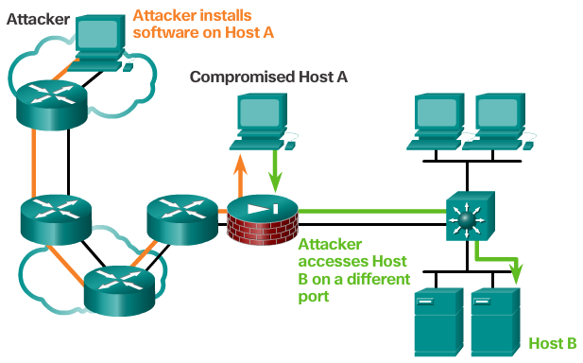
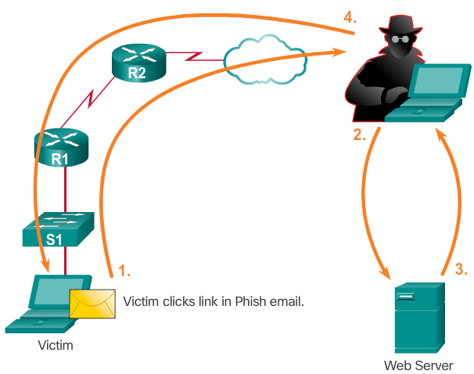
Access Attacks (cont.)
Port Redirection
Man-in-the-Middle
Notes:
11.2.2.3 Access Attacks (Cont.)

Slide 29
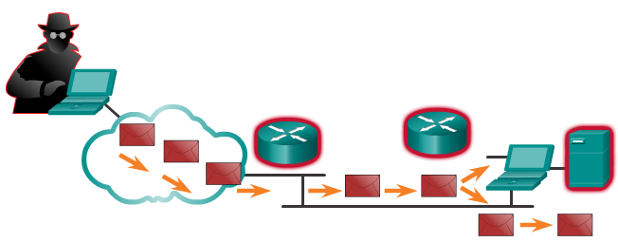
Denial of Service Attacks
Denial of Service (DoS) attacks are difficult to eliminate.
DoS attacks are regarded as trivial and require little effort to execute.
Although simple, DoS attacks are still dangerous.
Ultimately, they prevent authorized people from using a service by consuming system resources.
To help prevent DoS attacks it is important to have the latest security updates.
Notes:
11.2.2.4 Denial of Service Attacks

Slide 30
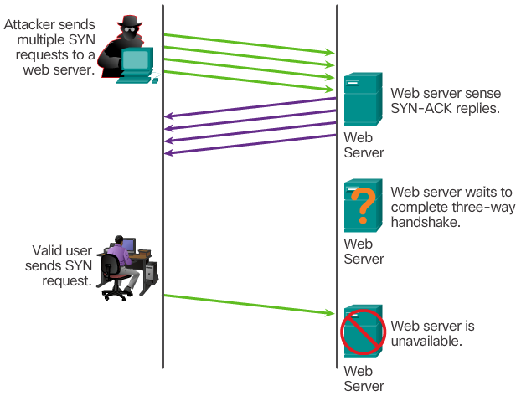
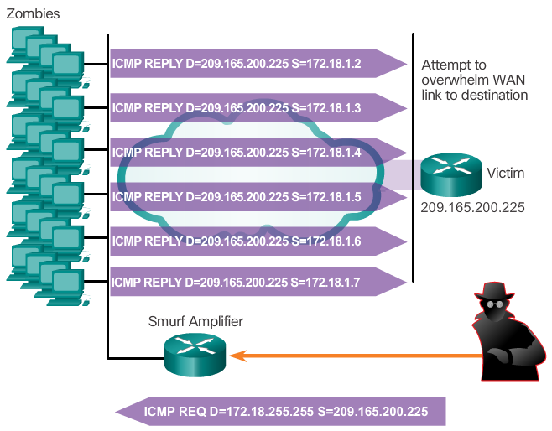
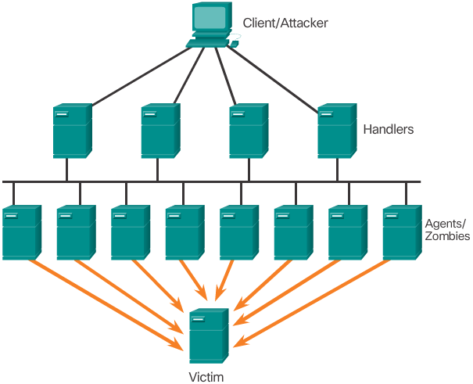
Denial of Service Attacks (cont.)
SYN Flood
Common DoS Attacks:
Ping of Death
SYN Flood
DDoS
Smurf Attack
Smurf Attack
DDos
Notes:
11.2.2.4 Denial of Service Attacks (Cont.)

Slide 31
Topic 11.2.3: Network Attack Mitigation

Slide 32
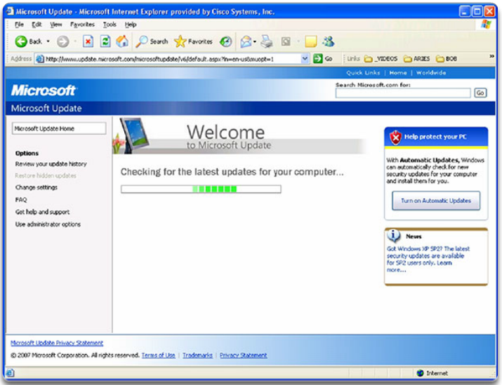
Backup, Upgrade, Update, and Patch
Keeping up-to-date with the latest developments can lead to a more effective defense against network attacks.
As new malware is released, enterprises need to keep current with the latest versions of antivirus software.
To mitigate worm attacks, patches for all known vulnerabilities must be applied.
A central patch server can be a good solution for managing a large number of servers and systems.
Any patches that are not applied to a host are automatically downloaded from the patch server and installed without user intervention.
Notes:
11.2.3.1 Backup, Upgrade, Update, and Patch

Slide 33
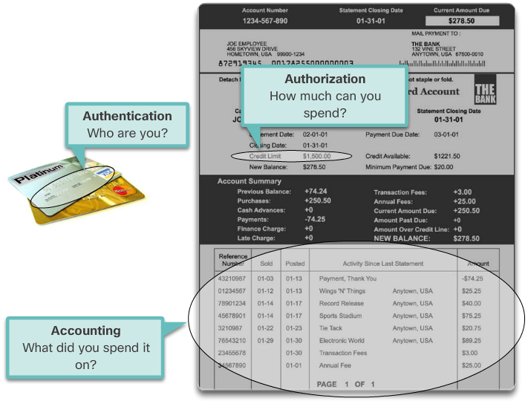
Authentication, Authorization, and Accounting
AAA services provide access control on a network device.
AAA is a way to control who is permitted to access a resource (authenticate), what they can do while they are there (authorize), and what actions they perform while accessing the resource (accounting).
The AAA framework can be very helpful when mitigating network attacks.
Notes:
11.2.3.2 Authentication, Authorization, and Accounting

Slide 34
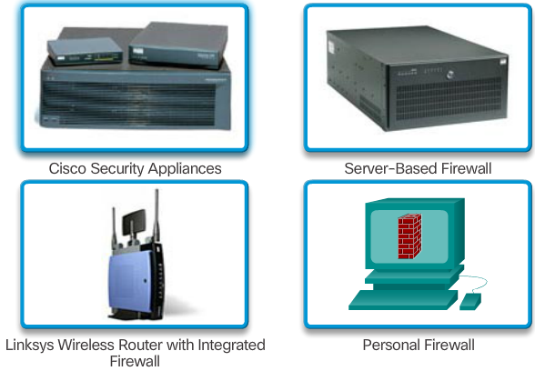
Firewalls
A firewall controls the traffic and helps prevent unauthorized access
Techniques for determining what is permitted or denied access to a network include:
Packet filtering
Application filtering
URL filtering
Stateful packet inspection (SPI)
Notes:
11.2.3.3 Firewalls

Slide 35

Endpoint Security
Common endpoints are laptops, desktops, servers, smartphones, and tablets.
Securing endpoint devices is challenging.
Employees need to be trained on proper use of the network.
Policies often include the use of antivirus software and host intrusion prevention.
More comprehensive endpoint security solutions rely on network access control.
Notes:
11.2.3.4 Endpoint Security

Slide 36
Topic 11.2.4: Device Security

Slide 37
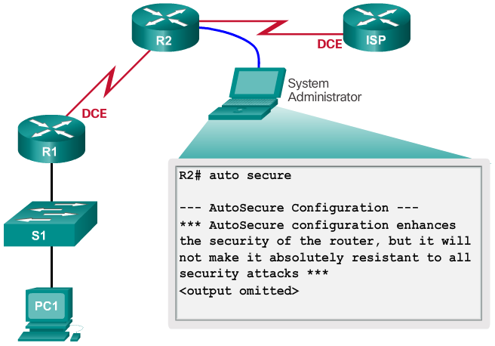
Device Security Overview
Default settings are dangerous because they are well-known.
Cisco routers have the Cisco AutoSecure feature.
In addition, the following apply for most systems:
Change default usernames and passwords immediately
Restrict access to system resources to authorized individuals only.
Turn off unnecessary services.
Update any software and install any security patches prior to production operation.
Notes:
11.2.4.1 Device Security Overview

Slide 38
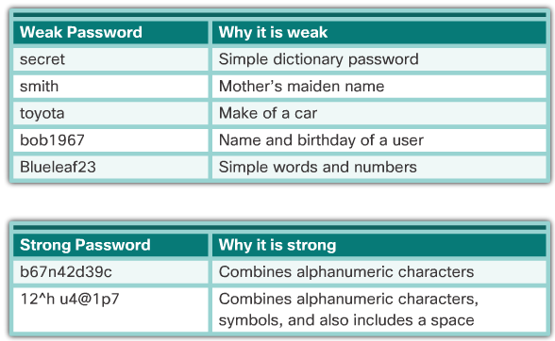
Passwords
Use strong passwords. A strong password has/is:
At least 8 characters, preferably 10 or more
A mix of uppercase and lowercase letters, numbers, symbols, and spaces.
No repetition, no common dictionary words, no letter or number sequences, no usernames, relative, or pet names, and no other easily identifiable pieces of information
Misspelled words
Changed often
Cisco routers support the use of a phrase made of many words, which is called a passphrase.
Notes:
11.2.4.2 Passwords

Slide 39
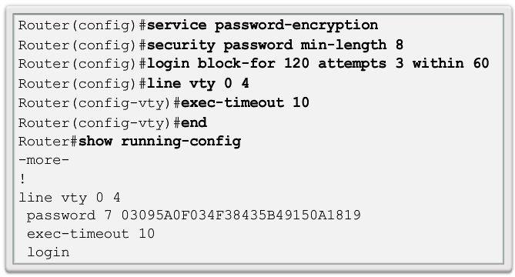
Basic Security Practices
Strong passwords are only as useful as they are secret.
The service password-encryption command encrypts the passwords in the configuration.
The security passwords min-length command ensures all configured passwords have a minimum specified length.
Blocking several consecutive login attempts helps minimize password brute-force attacks.
login block-for 120 attempts 3 within 60 will block login attempts for 120 seconds if there are three failed login attempts within 60 seconds.
Exec Timeout automatically disconnect idle users on a line
Notes:
11.2.4.3 Basic Security Practices

Slide 40
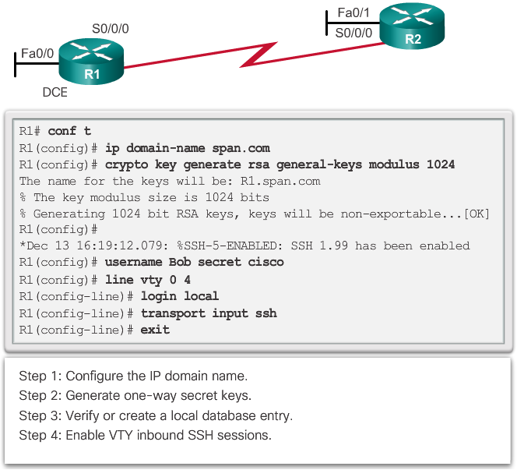
Enable SSH
Telnet is not secure.
It is highly recommended to use SSH for remote shell protocol.
To configure a Cisco device to support SSH takes four steps:
Step 1. Ensure that the router has a unique hostname and a IP domain name.
Step 2. Generate the SSH keys.
Step 3. Create a local username.
Step 4. Enable vty inbound SSH sessions.
The router can now be remotely accessed only by using SSH.
Notes:
11.2.4.4 Enable SSH
11.2.4.5 Packet Tracer – Configuring Secure Passwords and SSH
11.2.4.6 Lab – Accessing network Devices with SS
11.2.4.7 Lab – Examining Telnet and SSH in Wireshark
11.2.4.8 Lab – Securing Network Devices

Slide 41
Topic 11.2.5: Backup and Restore Configuration Files

Slide 42
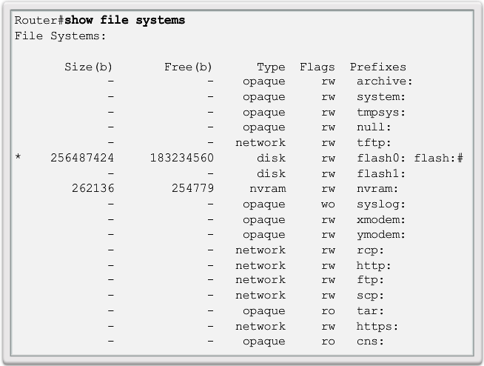
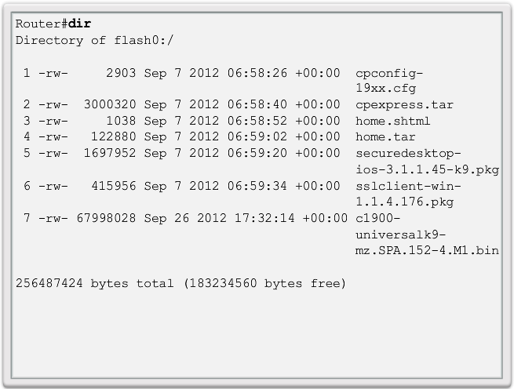
Router File Systems
File Systems
The Cisco IOS File System (IFS) allows for file system read and write operations.
Use the show file systems command lists all of the available file systems
This course focuses on tftp, flash, and nvram file systems. The bootable IOS image is located in flash.
The Flash File System
Commonly the largest file system in a Cisco router.
Commonly stores the IOS image.
Use the dir command to list the contents of the flash or any other file system.
The NVRAM File System
Commonly used to store the configuration files.
It is not common for a IOS to have a large NVRAM.
Flash
Notes:
11.2.5.1 Router File Systems

Slide 43
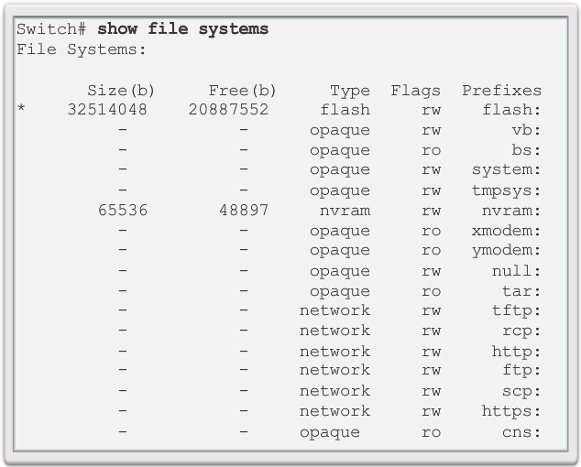
Switch File Systems
Cisco 2960 Switch
Is similar to the router’s file system.
The Cisco 2960 switch flash file system supports configuration files, copy, and archive (upload and download) software images.
Same command as on the router to view the file systems: show file systems
Notes:
11.2.5.2 Switch File Systems

Slide 44
Backing up and Restoring using Text Files
Backing up the Configuration
Configuration files can be saved/archived to a text file.
For Tera Term the steps are:
Step 1. On the File menu, click Log.
Step 2. Choose the location to save the file. Tera Term will begin capturing text.
Step 3. Any text displayed in the terminal window will be directed to the chosen file.
Step 4. When the capture is complete, select Close in the Tera Term: Log window.
Step 5. View the file to verify that it was not corrupted.
Restoring the Configuration
A configuration can be copied from a file to a device.
IOS executes any text pasted into a terminal window as a command.
The device must be set at the global configuration mode.
For Tera Term, the steps are:
Step 1. On the File menu, click Send file.
Step 2. Locate the file to be copied into the device and click Open.
Step 3. Tera Term will paste the file into the device. The text in the file will be applied as commands in the CLI and become the running configuration on the device.
Notes:
11.2.5.3 Backing up and Restoring using Text Files

Slide 45
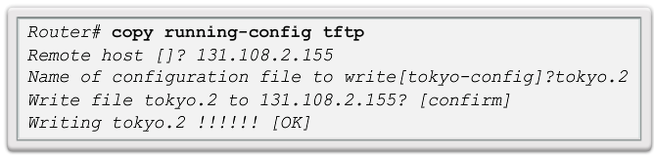
Backing up and Restoring TFTP
Backup running configuration
Step 1. Enter the copy running-config tftp command.
Step 2. Enter the IP address of the host where the configuration file will be stored.
Step 3. Enter the name to assign to the configuration file.
Step 4. Press Enter to confirm each choice.
Restore running configuration
Step 1. Enter the copy tftp running-config command.
Step 2. Enter the IP address of the host where the configuration file is stored.
Step 3. Enter the name to assign to the configuration file.
Step 4. Press Enter to confirm each choice.
Notes:
11.2.5.4 Backing up and Restoring TFTP

Slide 46
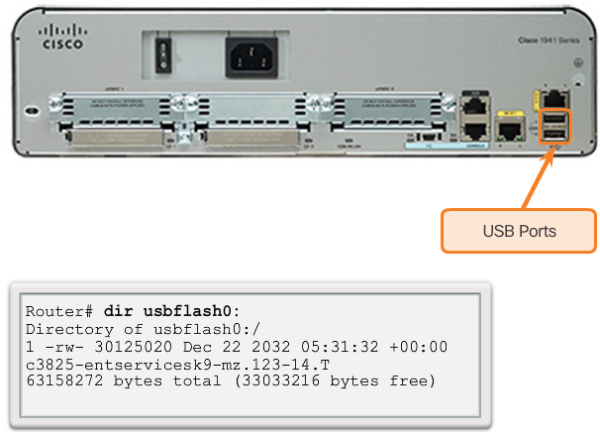
Using USB Ports on a Cisco Router
Cisco 1941 Router USB Port
Certain models of Cisco routers support USB flash drives.
The USB flash feature provides an optional secondary storage capability and an additional boot device.
It can hold images, configurations, and other files.
USB flash can hold multiple copies of the Cisco IOS and multiple router configurations.
Use the dir command to view the contents of the USB flash drive, as shown in the figure.
Notes:
11.2.5.5 Using USB Ports on a Cisco Router

Slide 47
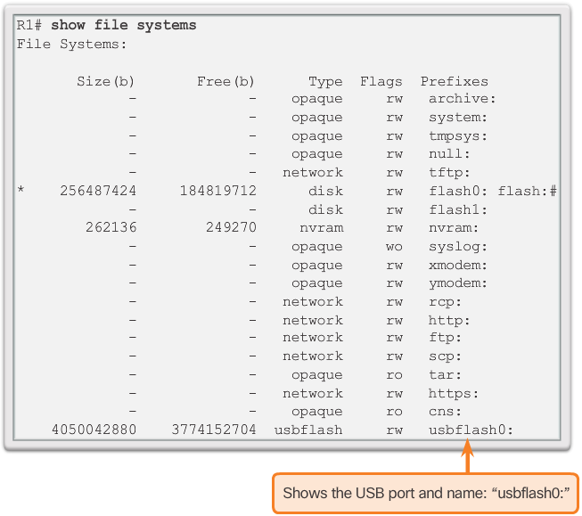
Backup and Restoring using USB
Backup Configurations with a USB Flash Drive
Confirm the drive is present with show file systems.
Use the copy run usbflash0:/ command to copy the configuration file to the USB flash drive.
The IOS will prompt for the filename.
Use the dir command to see the file on the USB drive.
Restore Configurations with a USB Flash Drive
Assuming the file name is R1-Config, use the command copy usbflash0:/R1-Config running-config to restore a running configuration.
Notes:
11.2.5.6 Backup and Restoring using USB (Cont.)
11.2.5.7 Packet Tracer – Backing up Configuration Files
11.2.5.8 Lab – Managing Router Configuration Files with Tera Term
11.2.5.9 Lab – Managing Device Configuration Files Using TFTP, Flash, and USB
11.2.5.10 Lab – Researching Password Recovery Procedures

Slide 48
Section 11.3: Basic Network Performance
Upon completion of this section, you should be able to:
Use the output of the ping command to establish relative network performance.
Use the output of the tracert command to establish relative network performance.
Use show commands to verify the configuration and status of network devices.
Use host and IOS commands to acquire information about network devices.

Slide 49
Topic 11.3.1: The ping Command

Slide 50
Interpreting Ping Results
IOS Ping Indicators
Using the ping command is an effective way to test connectivity.
Use the Internet Control Message Protocol (ICMP) to verify Layer 3 connectivity.
The ping command can help to identify the source of the problem.
A ping issued from the IOS will yield one of several indications for each ICMP echo request that was sent. The most common indicators are:
! - Indicates receipt of an ICMP echo reply message.
. - Indicates time expired while waiting for an ICMP echo reply message
U - Indicates that an ICMP unreachable message was received
Notes:
11.3.1.1 Interpreting Ping Results

Slide 51
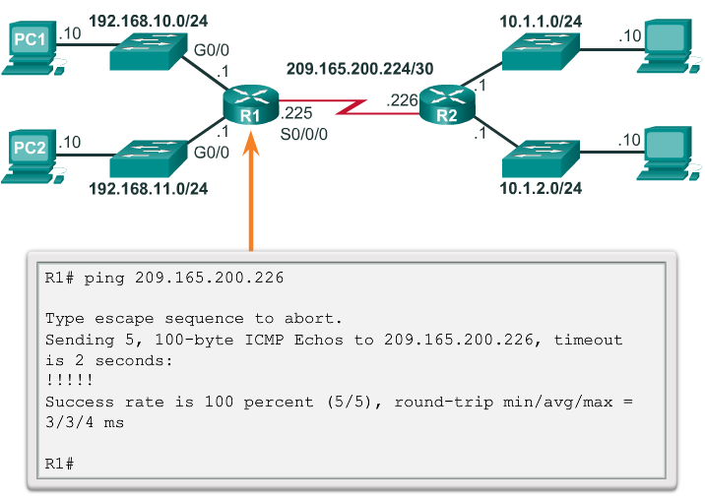
Interpreting Ping Results (cont.)
IOS Ping Indicators
The "." (period) may indicate that a connectivity problem occurred somewhere along the path. A number of reasons can result in this indicator:
A router along the path did not have a route to the destination.
The ping was blocked by device security.
The ping timed out before another protocol’s response was received (ARP, for instance).
The "U" indicates that a router along the path responded with an ICMP unreachable message. The router either did not have a route to the destination address or the ping request was blocked.
Notes:
11.3.1.1 Interpreting Ping Results (Cont.)

Slide 52
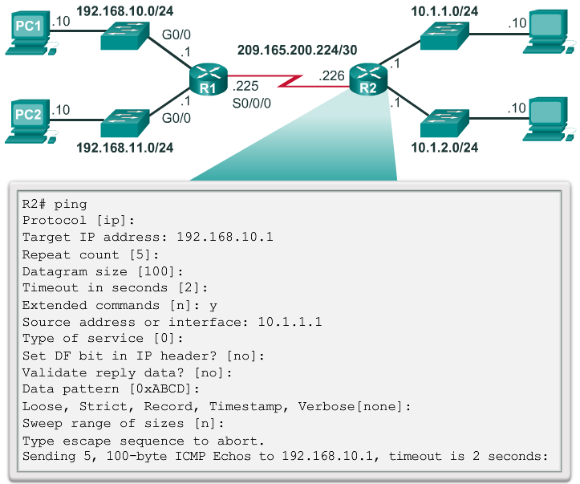
Extended Ping
The Cisco IOS offers an "extended" mode of the ping command.
This mode is entered by typing ping in privileged EXEC mode, without a destination IP address.
A series of prompts are then presented.
Pressing Enter accepts the indicated default values.
Notes:
11.3.1.2 Extended Ping

Slide 53
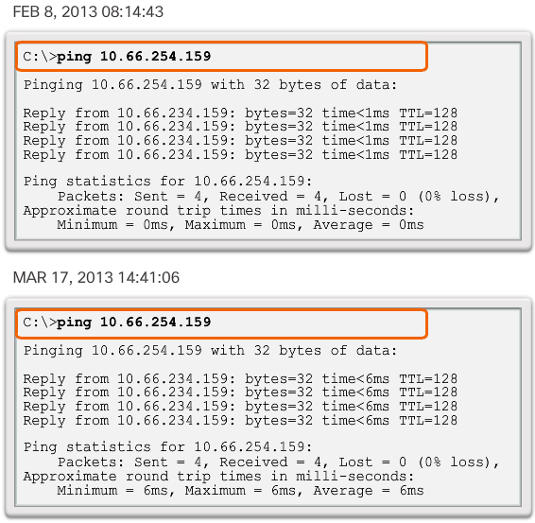
Network Baseline
A network baseline is a very important tool.
An effective network performance baseline is built over a period of time.
The output derived from network commands can contribute data to the network baseline.
A baseline can be created by copying and pasting the results from an executed ping, trace, or other relevant commands into a text file.
These text files can be time stamped for later comparison.
Among items to consider are error messages and the response times from host to host.
If there is a considerable increase in response times, there may be a latency issue to address.
Notes:
11.3.1.3 Network Baseline

Slide 54
Topic 11.3.2: The traceroute and tracert Command

Slide 55
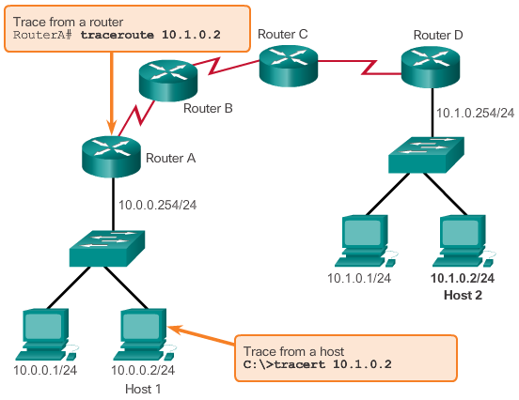
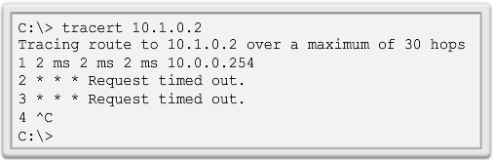
Interpreting Trace Messages
A trace returns a list of hops as a packet is routed through a network.
The form of the command depends on the platform.
Use tracert for Windows-based systems and traceroute for Cisco IOS and UNIX-based systems.
Tracing the Route from Host 1 to Host 2
Testing the Path to a Remote Host
Notes:
11.3.2.1 Interpreting Trace Messages
11.3.2.2 Packet Tracer – Test Connectivity with Traceroute
11.3.2.3 Lab – Testing Network Latency with Ping and Traceroute

Slide 56
Topic 11.3.3: Show Commands

Slide 57
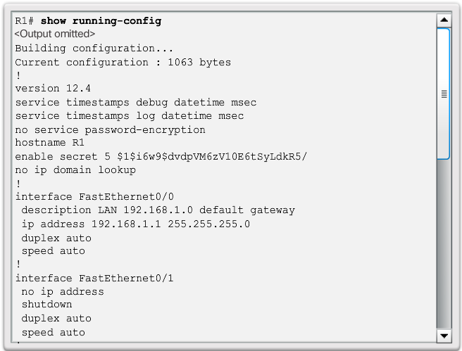
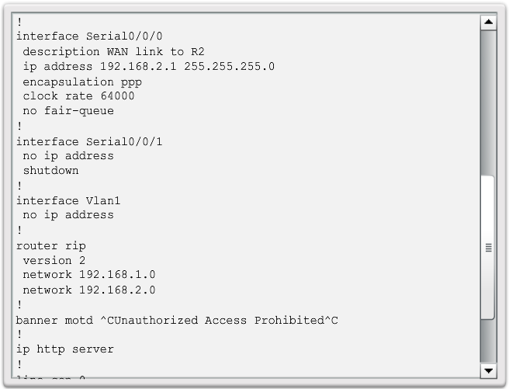
Common show Commands Revisited
The Cisco IOS CLI show commands are powerful troubleshoot tools.
The show commands display configuration files, checking the status of device interfaces and processes, and verifying the device operational status.
The status of nearly every process or function of the router can be displayed using a show command.
Some of the more popular show commands are:
show running-config
show interfaces
show arp
show ip route
show protocols
show version
Notes:
11.3.3.1 Common show Commands Revisited

Slide 58
Topic 11.3.4: Host and IOS Commands

Slide 59
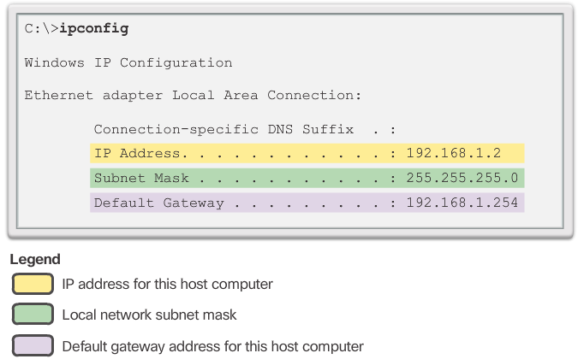
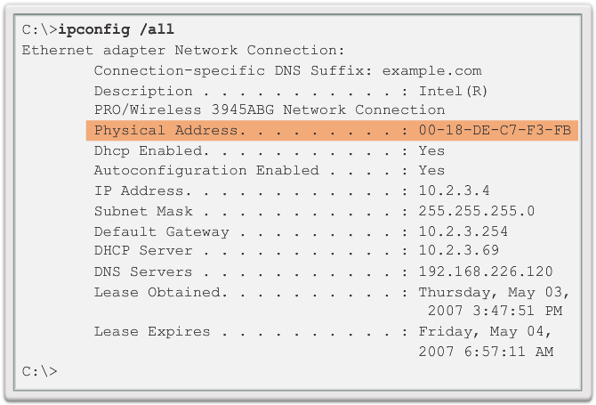
The ipconfig Command
ipconfig
The ipconfig command can be used to display IP information on a Windows-based computer.
The ipconfig command displays the host and its default gateway IP addresses.
Use the ipconfig /all command to view the host’s IP configuration in more detail, including its MAC address.
The ipconfig /displaydns command displays all of the cached DNS entries on a Windows-based computer system.
ipconfig /all
Notes:
11.3.4.1 The ipconfig Command

Slide 60
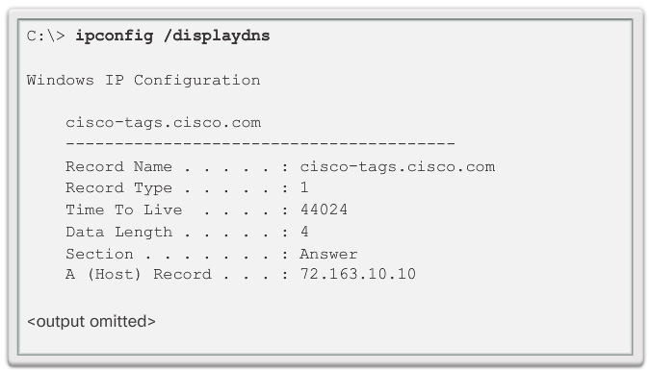
The ipconfig Command (cont.)
ipconfig /displaydns
Notes:
11.3.4.1 The ipconfig Command (Cont.)

Slide 61
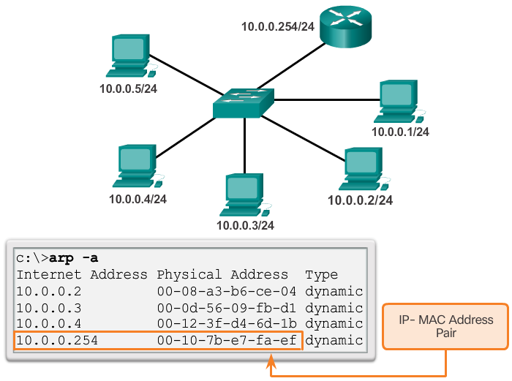
The arp Command
The arp –a command lists all devices currently in the ARP cache of the host.
It also includes the IPv4 address, physical address, and the type of addressing (static/dynamic), for each device.
The cache can be cleared by using the arp -d command.
Notes:
11.3.4.2 The arp Command

Slide 62
The show cdp neighbors Command
CDP is a Cisco-proprietary protocol that runs at the data link layer.
Two or more Cisco network devices can learn about each other even if Layer 3 connectivity does not exist.
When a Cisco device boots, CDP starts by default.
CDP exchanges hardware and software device information with its directly connected CDP neighbors.
CDP provides:
Device identifiers
Address list
Port identifier
Capabilities list
Platform
Notes:
11.3.4.3 The show cdp neighbors Command

Slide 63
The show cdp neighbors Command (cont.)
The show cdp neighbors detail command reveals the IP address of a neighboring device.
CDP will reveal the neighbor's IP address regardless of whether you can ping the neighbor.
The show cdp neighbors detail command will help determine if one of the CDP neighbors has an IP configuration error.
CDP can be a security risk.
To disable CDP globally, use the global configuration command no cdp run.
To disable CDP on an interface, use the interface command no cdp enable.
Notes:
11.3.4.3 The show cdp neighbors Command (Cont.)

Slide 64

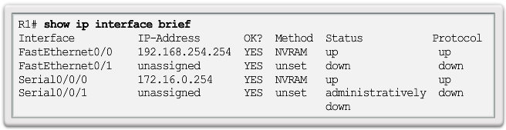
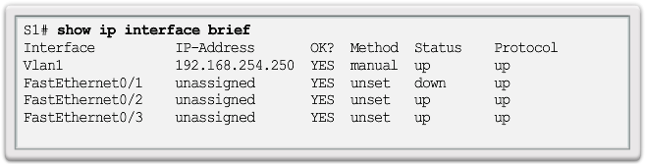
The show ip interface brief Command
The show ip interface brief command displays a summary of the key information for all the network interfaces on a router.
The show ip interface brief command can also be used to verify the status of the switch interfaces.
Notes:
11.3.4.4 The show ip interface brief Command
11.3.4.5 Activity – Show Commands
11.3.4.6 Lab – Using the CLI to Gather Network Device Information

Slide 65
Section 11.4: Summary
Chapter Objectives:
Explain how a small network can scale into a larger network.
Configure switches and routers with device hardening features to enhance security.
Use common show commands and utilities to establish a relative performance baseline for the network.
Explain how a small network of directly connected segments is created, configured, and verifies.
Notes:
11.4.1.1 Class Activity - Design and Build a Small Business Network
11.4.1.2 Packet Tracer - Skill Integration Challenge
11.4.1.3 Packet Tracer - Troubleshooting Challenge
11.4.1.4 Chapter 11: Build a Small Network

